Slide 1
Gender Classification
1

Slide 2
Contents...
Introduction
Dataset
EDA
Modeling
Conclusion
2

Slide 3
Introduction
A gender classification system uses face of a person from a given image to tell the gender (male/female) of the given person.
this can be carried through ML classification models such as KNN and Logistic Regression to classify the gender by the face sizes.
3

Slide 4

Dataset
The Dataset used is taken from “www.Kaggle.com”
The data has 5000 rows and 8 columns
4

Slide 5
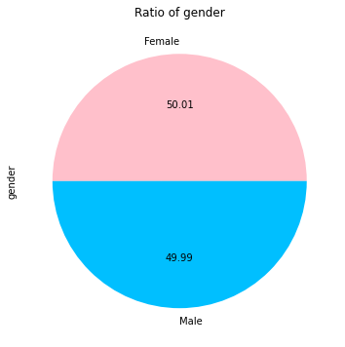
EDA
As we can see here my data is symmetric between male and female
5

Slide 6
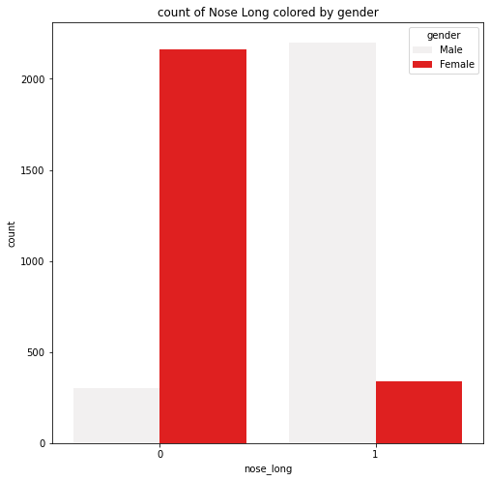
EDA
As we can see here that the men has bigger noses
6

Slide 7
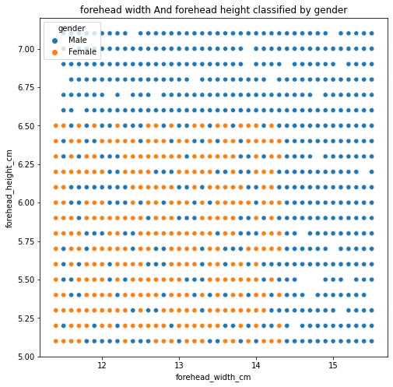
EDA
In this figure we can see that the women has smaller forehead
Than men
7

Slide 8
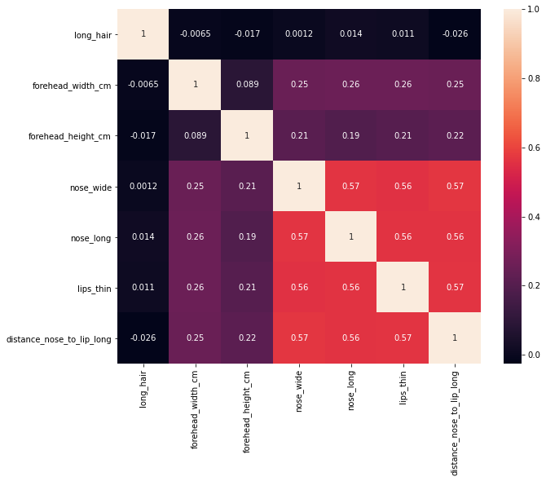
EDA
We can see in this correlation that the feature of long_hair does not effect our models
8

Slide 9
Modeling
After splitting data to train and test I used KNN to classify and I get accuracy of 96.2%
9

Slide 10
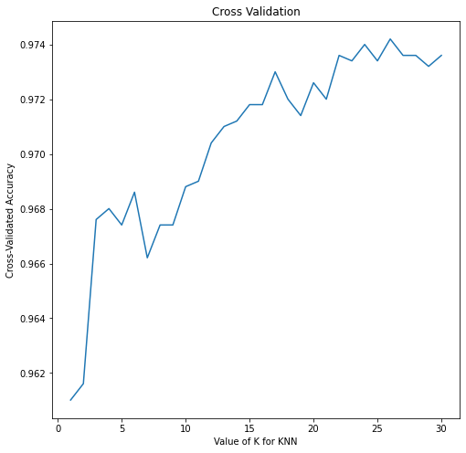
Modeling
Using Cross Validation as shown in figure we can see that the best neighbor is 26 with Accuracy of 97.4%
10

Slide 11
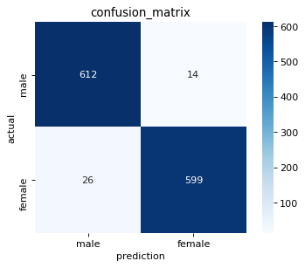
Modeling
Using the Confusion Matrix
11

Slide 12
Conclusion
Now we know the gender of a person passed on his face sizes by using Machine Learning classification models.
12

Slide 13
Thank you
13

